Slide 1


WEB SCRAPING ON AMBITION BOX

Slide 2
ABOUT US
BILLAKANTI RAVI
Completed my BTech in computer science & engineering
Learning Data Science gives solutions to real world problems
BANDI SHRAVAN
Worked as System Engineer at Infosys for 1.6 years
Learning Data Science gives us to recognize problems and develop solutions using the existing data.

Slide 3
PROBLEM STATEMENT
Job aspirants who are looking for a job will encounter 'N' number of problems like company ratings, reviews etc.
In our project we extracted the data from AMBITION BOX to give clear data to aspirants

Slide 4

LIBRARIES USED
NUMPY
PANDAS
MATPLOTLIB
SEABORN
BEAUTIFUL SOUP
PRETTIFY
REQUESTS

Slide 5
LIFE CYCLE OF DATA SCIENCE
PROBLEM STATEMENT/BUSINESS STATEMENT
DATA COLLECTION
DATA CLEANING
DATA ANALYSIS
DATA VISUALIZATION
FEATURE ENGINEERING
DATA MODELING
DATA EVALUATION
DEPLOYMENT

Slide 6
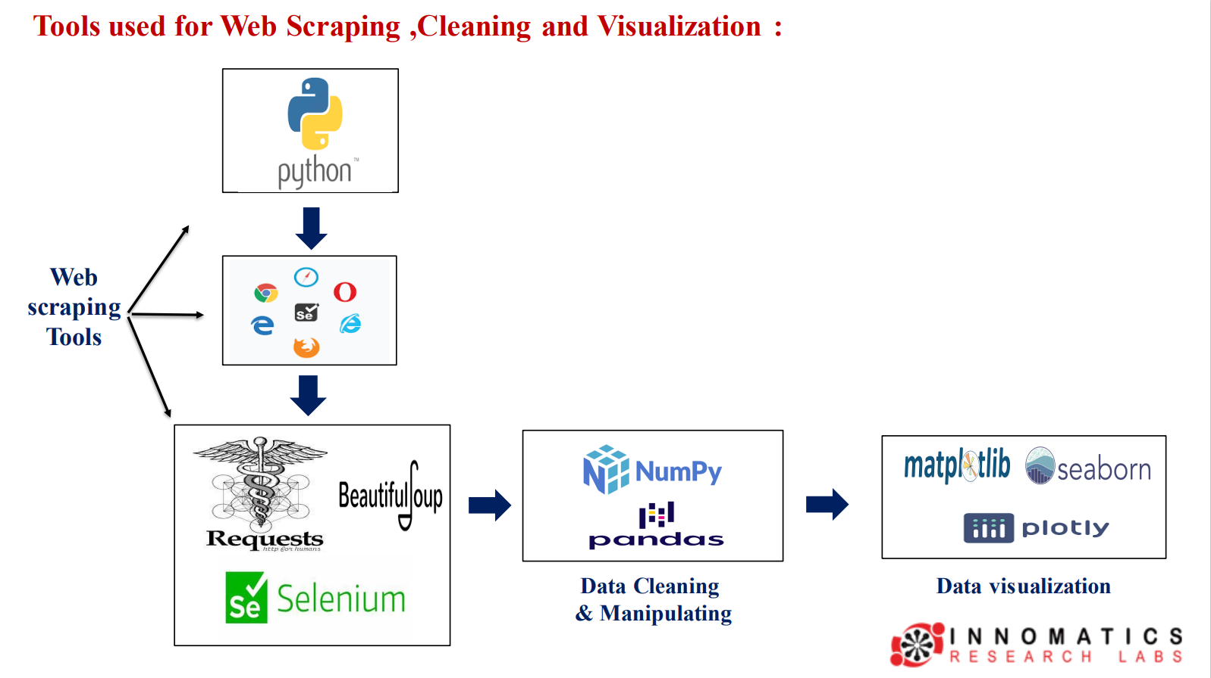

Slide 7
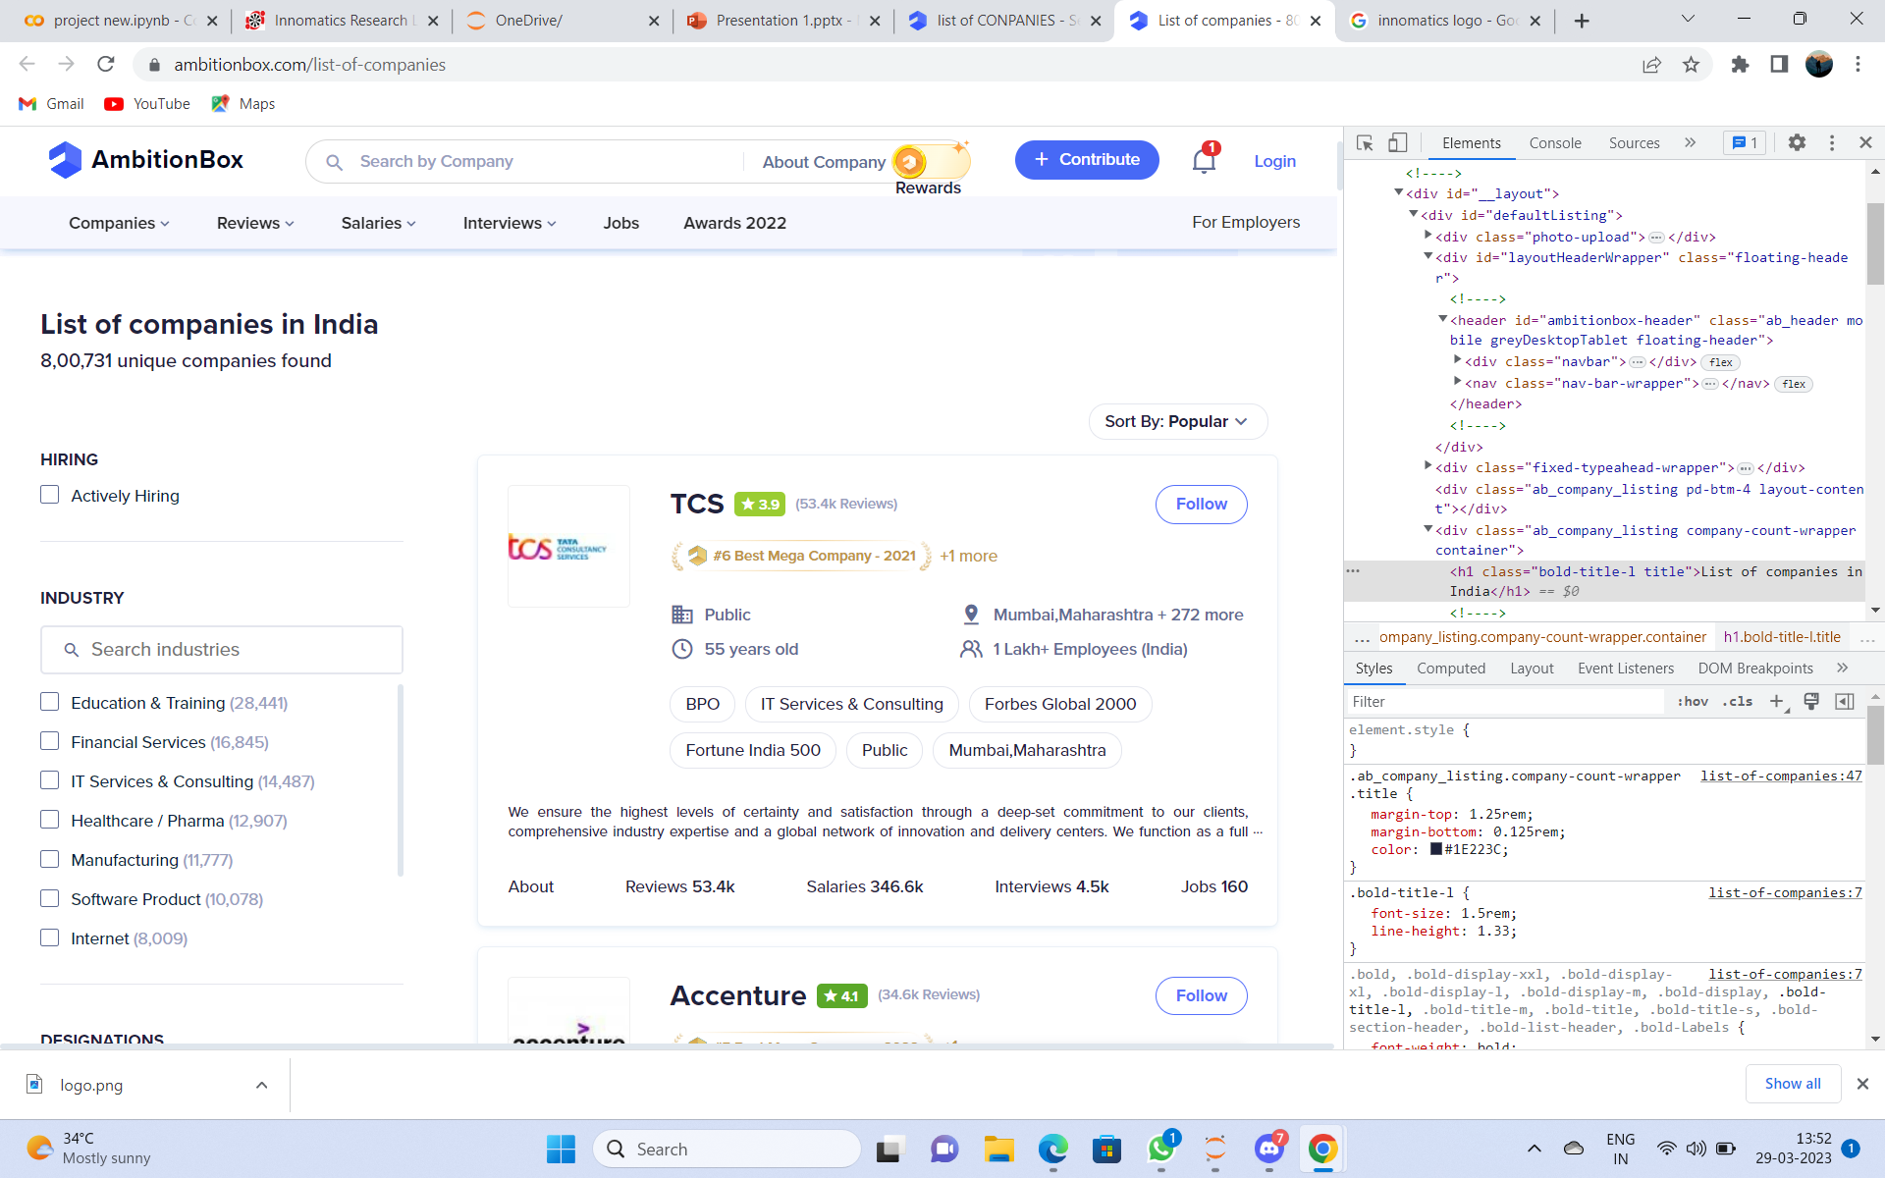
Website used for scraping:

Slide 8
Headers:
Headers used to access restricted content, as well as to provide information that can help identify your scraping script as a legitimate browser.
lxml is a python library for parsing html and xml files and extracting data
headers={'User-Agent':'Mozilla/5.0 (Windows NT 6.3; Win 64 ; x64) Apple WeKit /537.36(KHTML , like Gecko) Chrome/80.0.3987.162 Safari/537.36'}

Slide 9
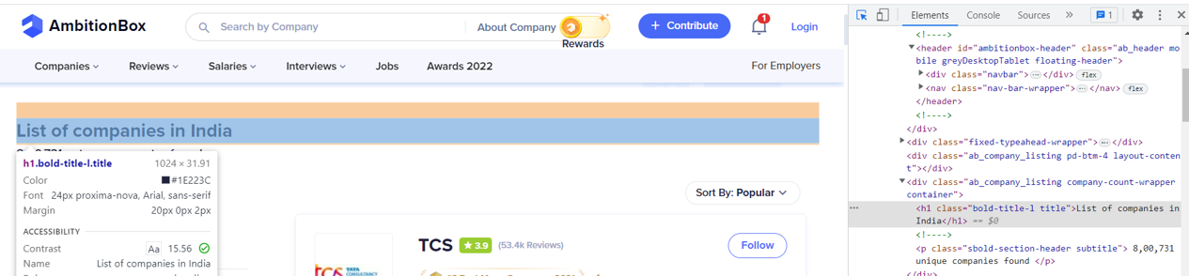
List of companies in India is in h1 tag, Can find it using BeautifulSoup

Slide 10
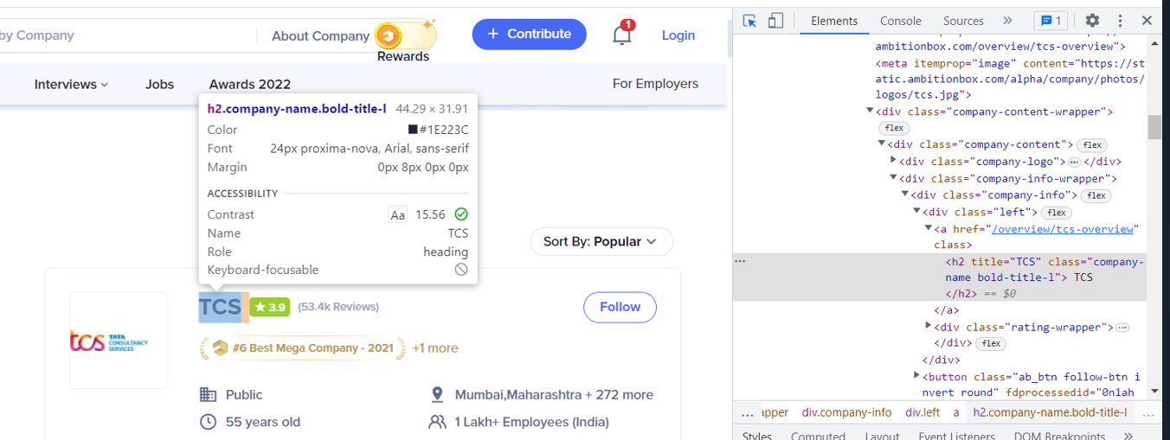
All the company names in the h2 tag

Slide 11
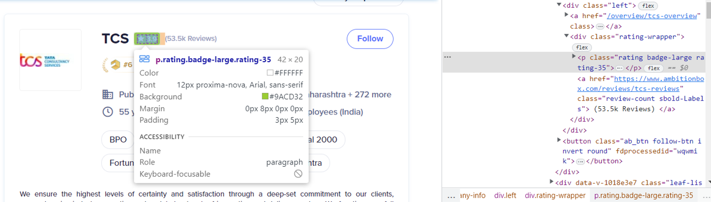
To find ratings of the company we use tag p

Slide 12
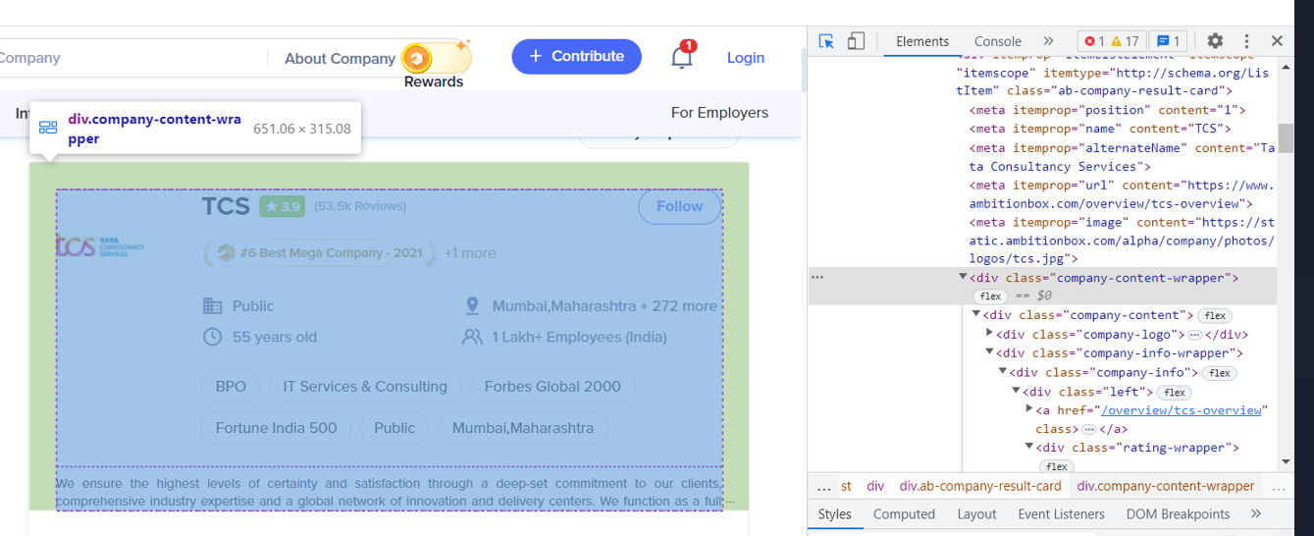
To check all the details of the company using div tag(company content wrapper)

Slide 13
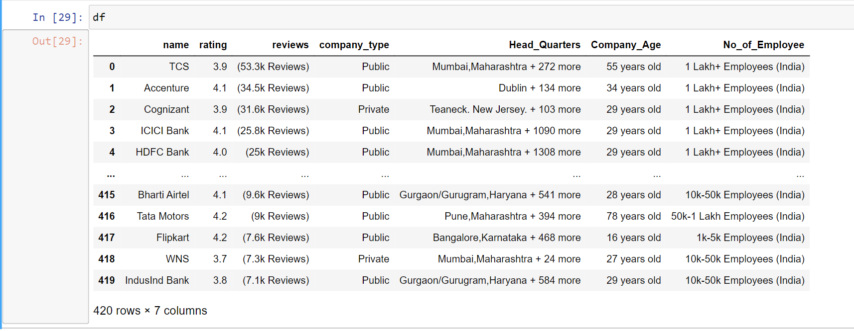
Collected raw data from ambition box, Before cleaning the data

Slide 14
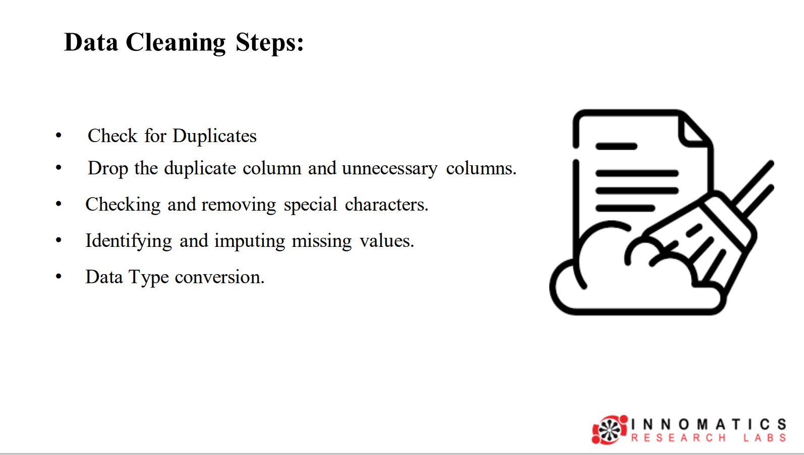

Slide 15
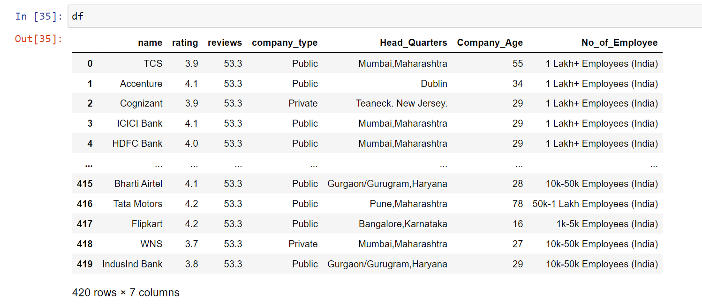
Cleaned Data

Slide 16
DATA ANALYSIS
UNIVARIATE ANALYSIS
BIVARIATE ANALYSIS
MULTIVARIATE ANALYSIS

Slide 17
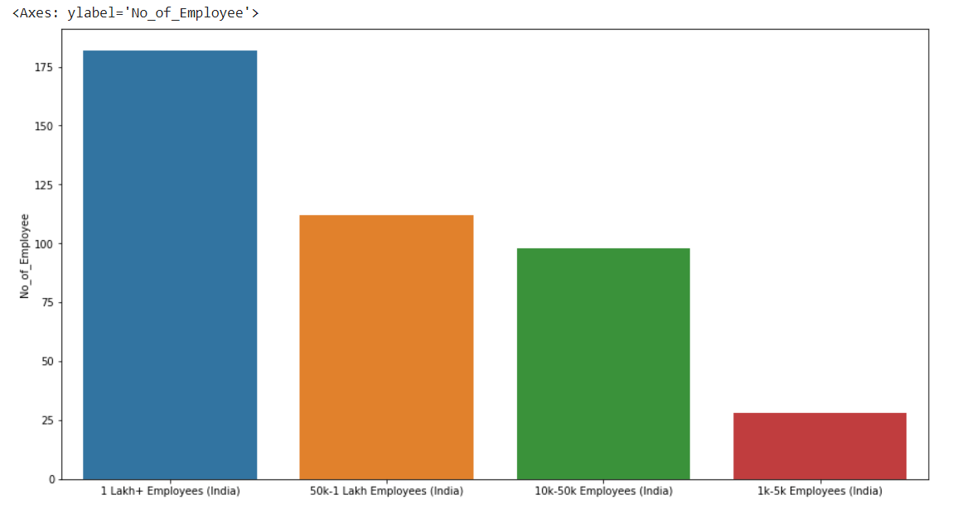
UNIVARIATE ANALYSIS
Number of employees count in companies in India​
OBSERVATIONS:
We can see that
1)Number of employees classified into four categories
2)We can check the number of employees from the highest to lowest

Slide 18
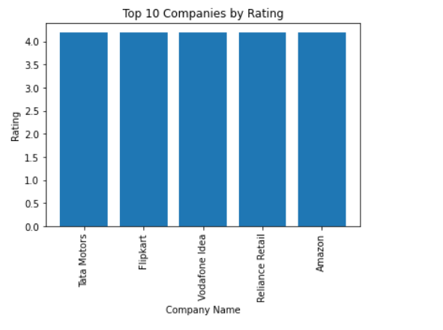
Top 10 companies by ratings:
Observations
Highest rating of top 10 companies
4.2 is the highest rating for all the top 10 companies

Slide 19
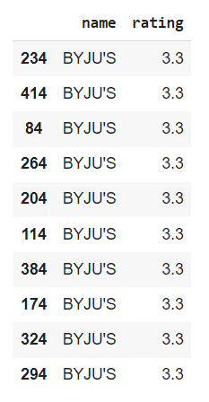
Least rating companies:

Slide 20
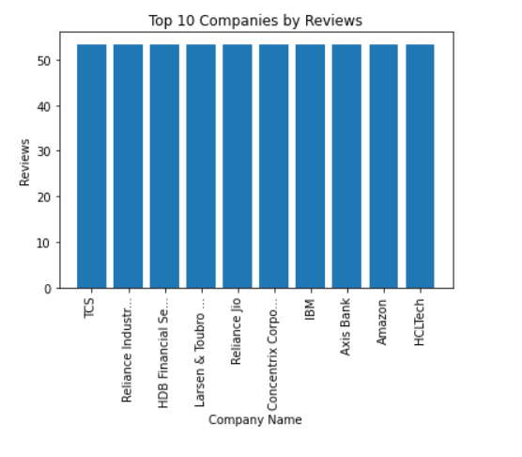
Top 10 Companies Reviews
Observations:
Highest reviews of top 10 companies
53.2k is the highest reviews for all the top 10 companies

Slide 21
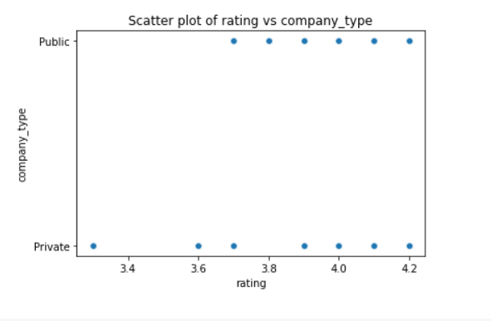
Rating vs Company type
Observations:
Public company rating starts from 3.7-4.2
Private company rating starts from 3.2-4.2

Slide 22
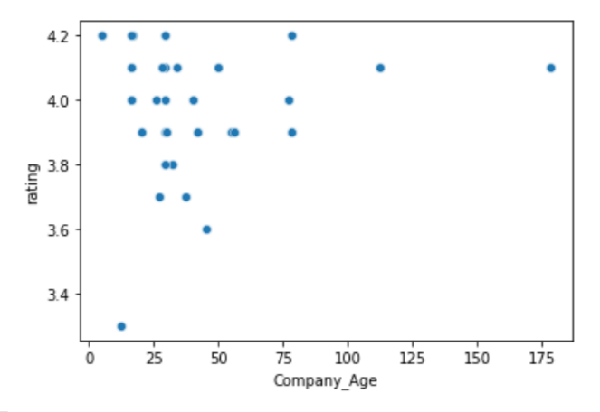
BIVARIATE ANALYSIS
Observation:
Here in the plot the distribution of rating based on company age
Less age company has less rating of 3.2 and highest age company has 4.1 rating

Slide 23
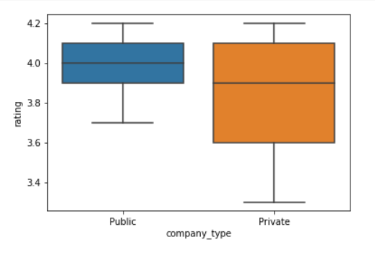
Observations:
Ratings displayed according to the company type
No outliers detected

Slide 24
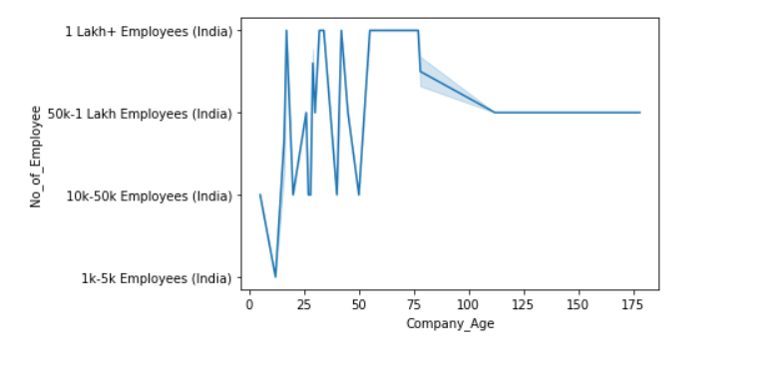
Lineplot of No.of employees vs Company age
Observations:
We can use this plot to see if there is any trend in the number of employees a company has as it ages.

Slide 25
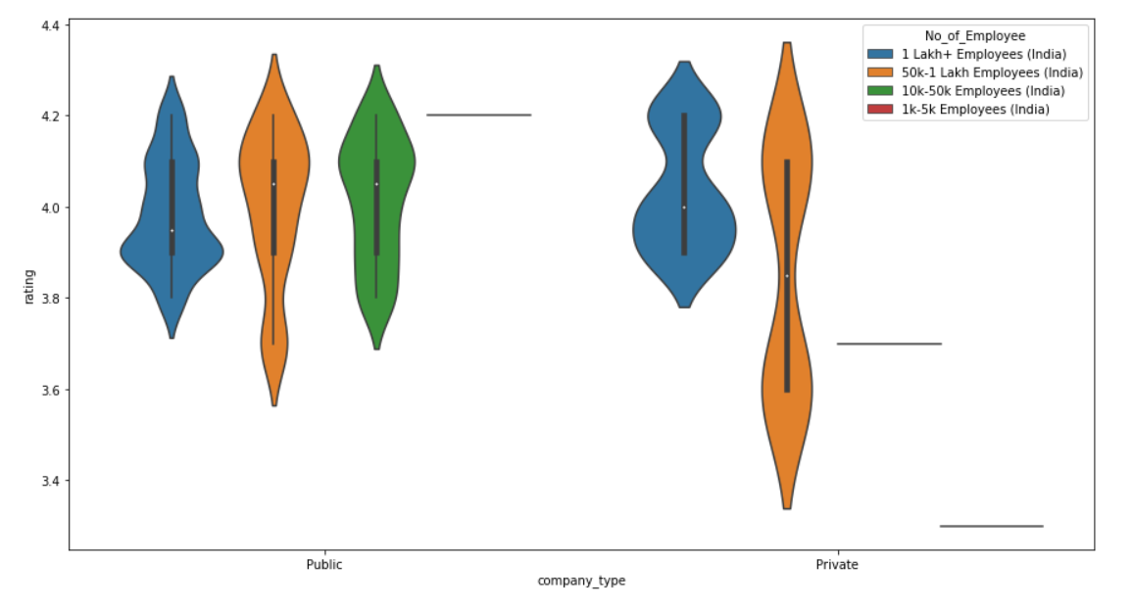
MULTIVARIATE ANALYSIS
Observation:
This will create a violin plot of Rating on the y-axis, with Company Type on the x-axis and Number of Employees as the hue. We can use this plot to see how the distribution of Rating varies based on both Company Type and Number of Employees.

Slide 26
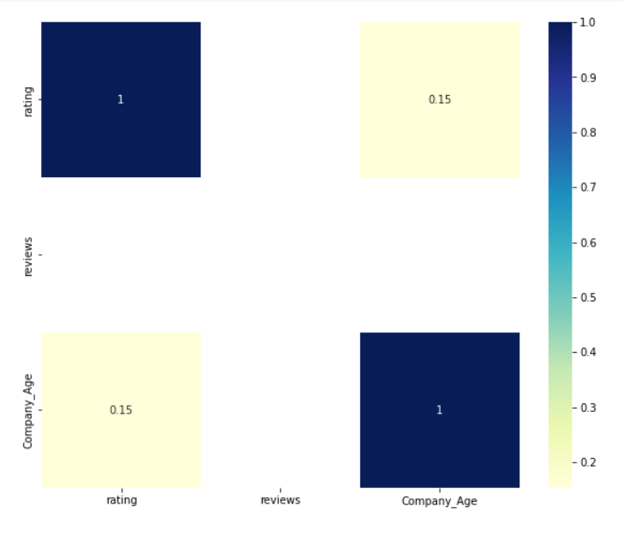
Heatmap
Observation:
This will create a heatmap showing the correlation between the numerical columns of the df dataframe. The values in each cell represent the correlation coefficient between the two variables.
Positive values indicate a positive correlation, negative values indicate a negative correlation, and values close to zero indicate little or no correlation.

Slide 27
Question & Answers:
1)Why we use headers for scrapping the data?
Headers used to access restricted content, as well as to provide information that can help identify your scraping script as a legitimate browser.
2)Which is the highest rated company?
Tata Motors (4.2)
3)Which is the lowest rated company?
Byjus (3.3)
4)From where public company rating starts from?
Public company rating starts from 3.7
5)From where private company rating starts from?
Private company rating starts from 3.2

Slide 28
Challenges found
Unable to scrap the ambition box data, we used headers to scrap the data
Reviews will be changed time to time
Job notifications of each company changes regularly

Slide 29
Conclusion:
We can get the top rated companies from both private and public sector companies.
We concluded the company ages accordingly.
We can know the head quarters of companies.
We got the total number of employees range from each company.

Slide 30

Thank You...

